Slide 1

Top 10 Songs of 2024

Slide 2
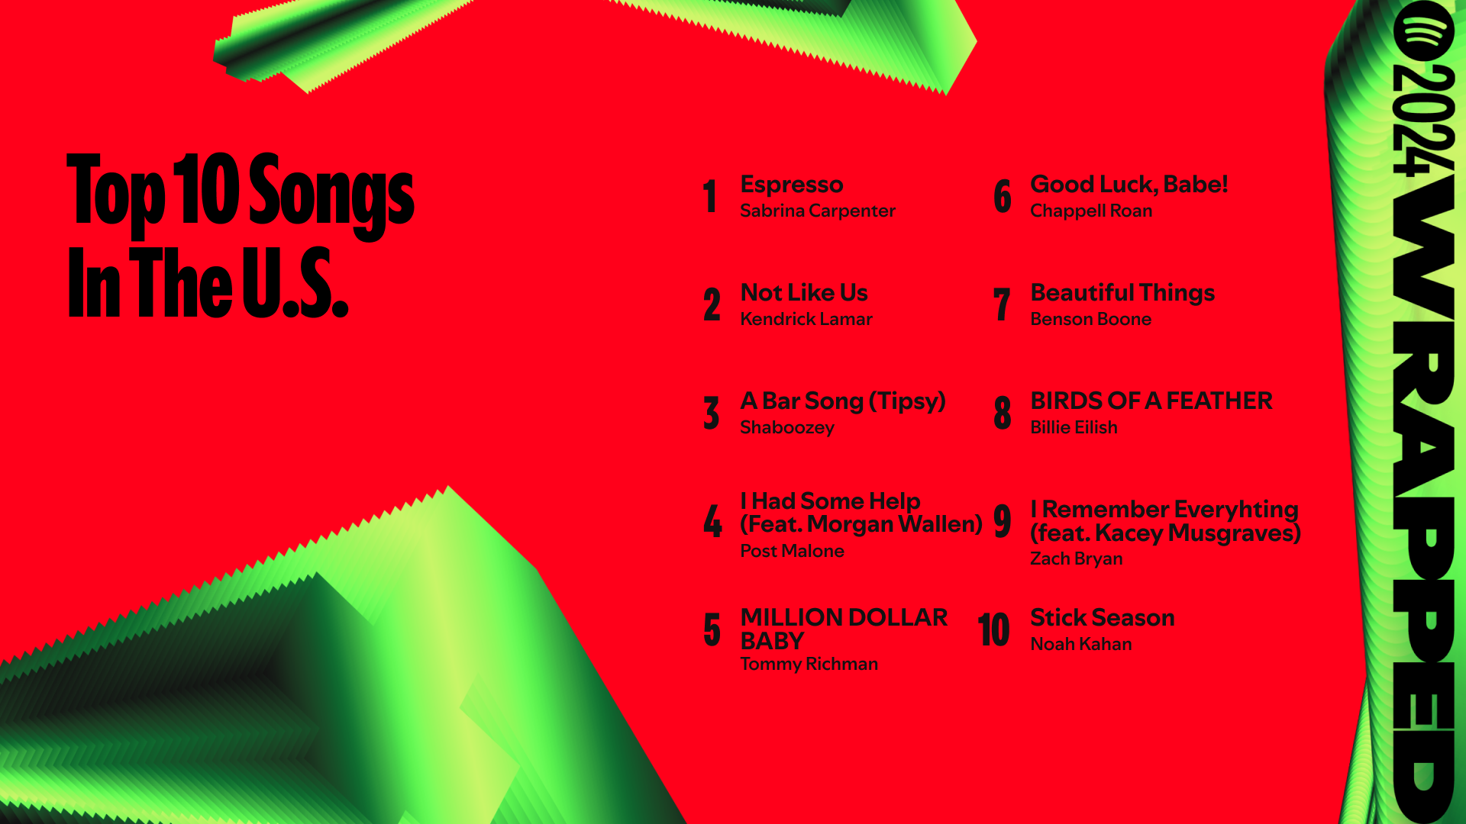

Slide 3

How to Make a Top 10 Song

Slide 4
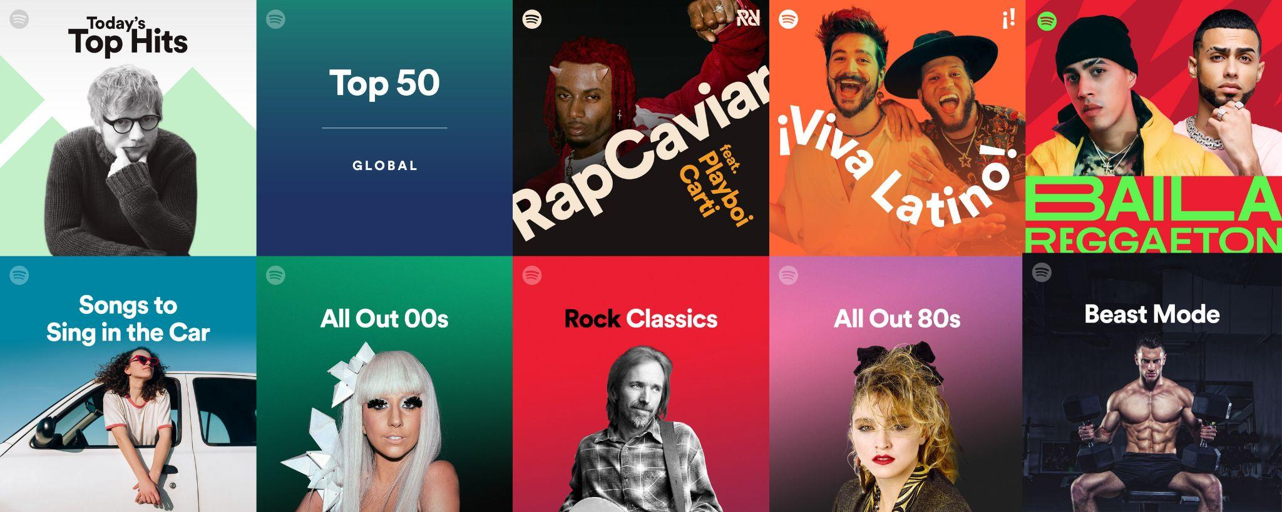
What is Our Problem?
Predicting a Top 10 Hit is challenging
Listener preferences are Subjective & Dynamic
Vast amounts of song data makes it difficult to identify potential hits
We aim to analyze song features and provide a data-driven approach to this challenge
Features include danceability, release date, tempo, etc.

Slide 5
Why this is Valuable
Efficiency
Saves time and resources by helping stakeholders focus on songs with the highest potential for success.
Insight for Artists
Helps artists understand song qualities that resonate with listeners.
Marketing Optimization Enables record labels to make informed decisions and refine marketing strategies.
Enhanced Playlists
Assists streaming platforms in optimizing recommendations and increasing listener engagement.

Slide 6
Artists
Record Labels
Consumers
Stakeholders
Streaming Platforms
Radio Stations

Slide 7
How would you DESCRIBE
a song?

Slide 8
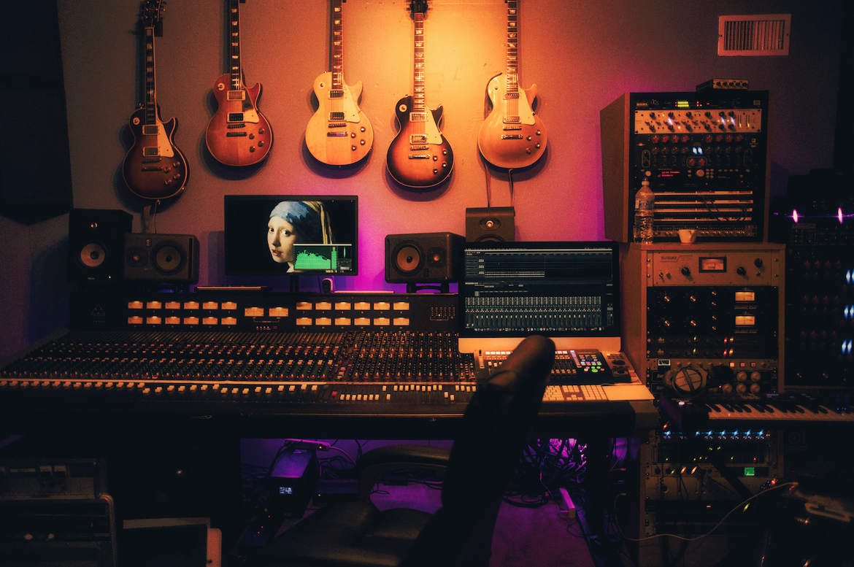
Musical Attributes
BPM (Beats per Minute) - Tempo of the song
Key/Mode - musical key of the song/major or minor key
Danceability - Suitability of the song for dancing
Valence - positivity or emotional content
Energy - reflecting intensity,tempo,volume
Acousticness -The degree of acoustic sound
Instrumentalness - Proportion of the song that is instrumental
Liveness - Presence of live performance elements
Speechiness - spoken words (e.g. rap or dialogue driven songs)

Slide 9
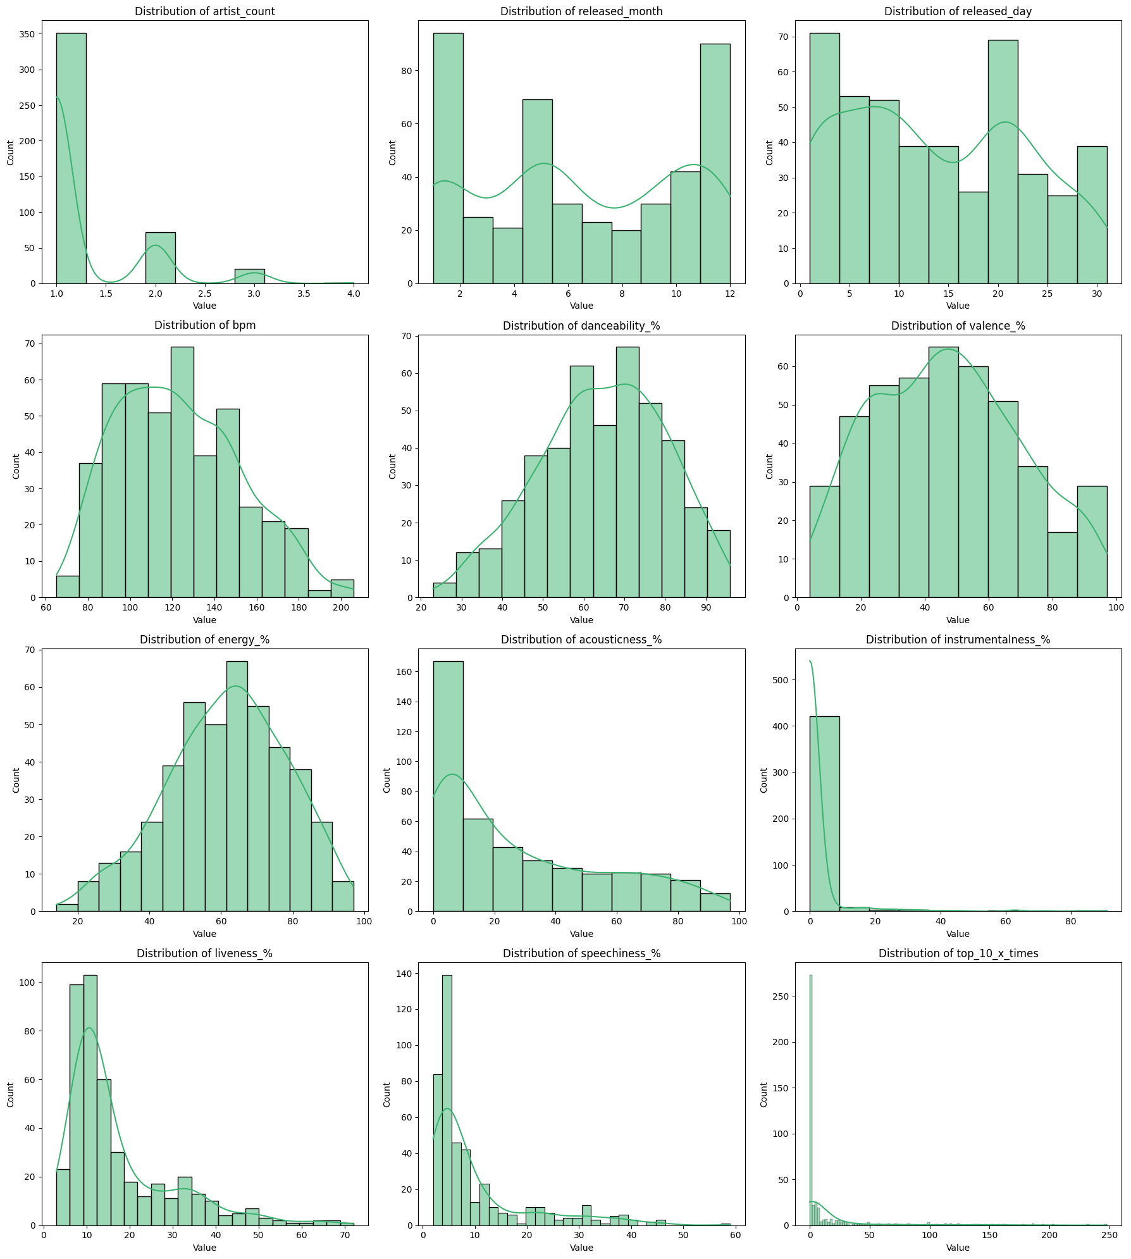
Understanding the Data
Song Tempo - 90-130 BPM
Energy - Moderate to High
Valence - Moderate
Mainstream Music - dominated by non-instrumental, studio-recorded songs with low acousticness and speechiness.
Seasonal Trends - March to July show higher releases indicating a possible marketing strategy.

Slide 10
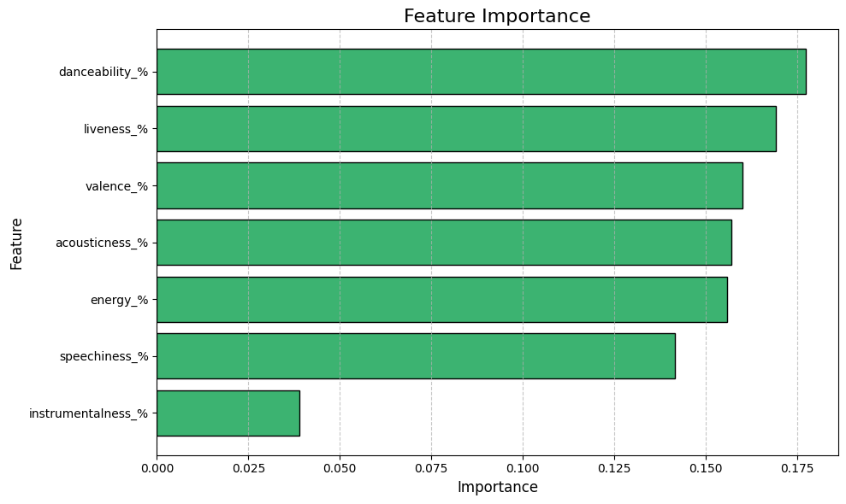
Feature Importance

Slide 11
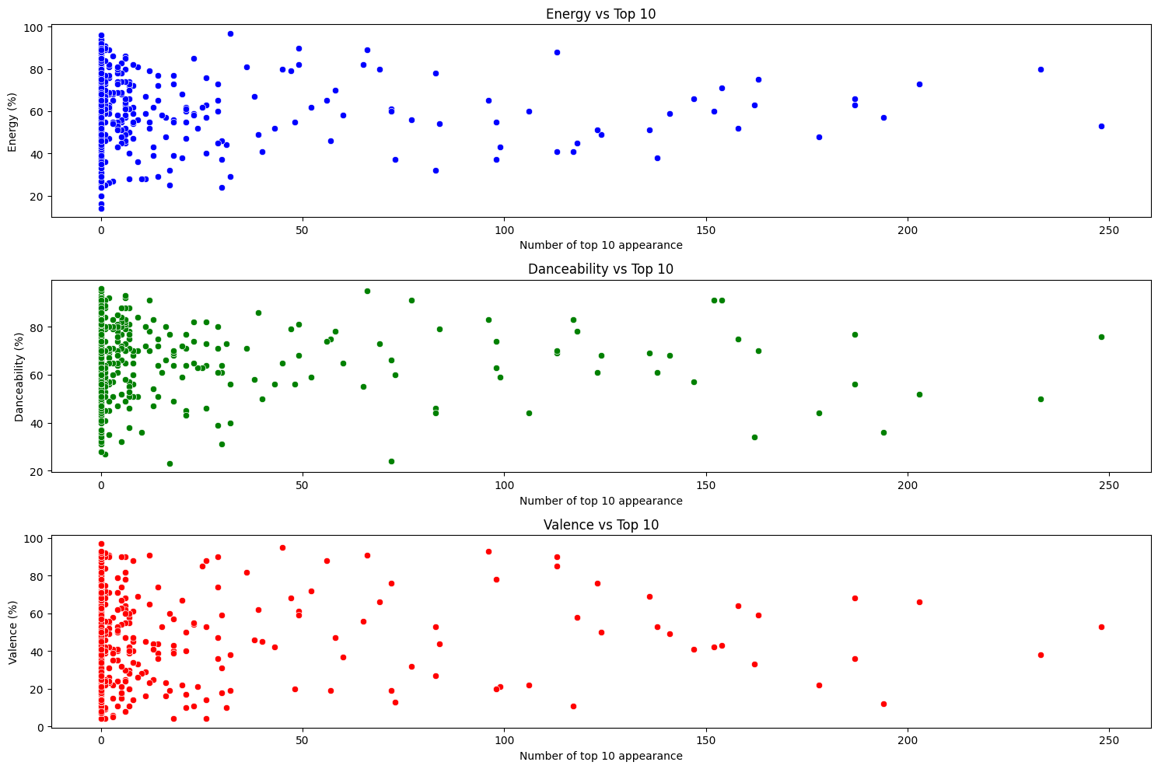
Top 3 features vs Top 10 Appearance
Key Insight: The graph shows a weak negative correlation, indicating that songs with higher valence (positivity) tend to appear in the top 10 less frequently. This suggests that, within this dataset, more positive songs may not perform as well in top 10 rankings compared to more neutral or negative songs.
Key Insight: There is no clear correlation between energy, danceability, and the number of top 10 appearances, indicating that these factors may not be strong determinants of a song's popularity

Slide 12
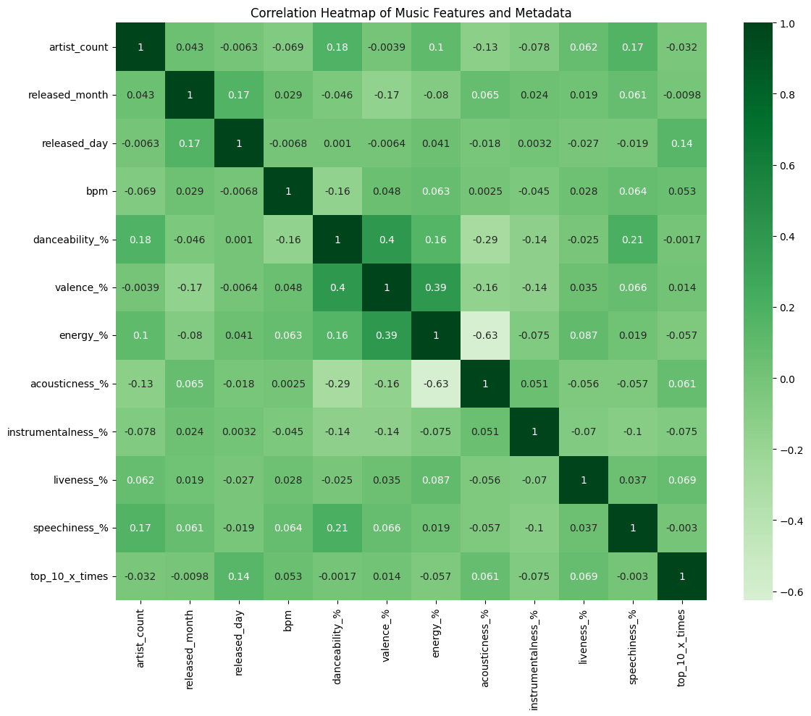
Correlation Heatmap for Selected Features

Slide 13
Data Preparation
Dataset is in Kaggle
We had to combine 2 datasets to get a prediction (y variable)
Dataset 1: musical attributes such as liveness, acousticness, bpm
Dataset 1: track info, streaming metrics and release date detail
Dataset 2: track info, and peak position, performance metrics
Combining datasets involved:
Matching song name and artist
Some songs had exact name with different artists
Additional artists were credited so wildcard match needed
For modeling the data, missing values replace with mean value
Notes:
Mean value was calculated for missing values for the data used specifically in the model.

Slide 14
Model Selection
Binary Classification (Is it a Top 10 song?)
Multiple models with Multiple Features Evaluated
Logistic Regression with Selected Features
Random Forest with Selected Features
Focused on features that are controlled such as:
Musical attributes (Liveness, Acousticness, BPM)
Number of Artists on Track
Release dates

Slide 15
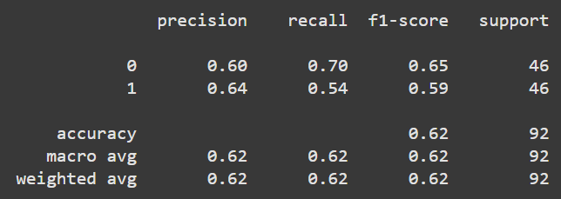
Model Final Selection
Random Forest with Selected Features
Accuracy is at 62%
Better than random guessing for a binary classification
We had similar results with Logistic Regression
In some cases results were more accurate
Overall accuracy was at 62% as well
Why choose Random Forest?
Future scalability
Random Forest is better at handling feature importances
The dimensionality of data can increase drastically
Ensemble learning, multiple iterations of feature tuning
Potential for non-linear and complex feature relationships

Slide 16
Evaluation
Our model is OKAY at predicting a Top 10 Hit
However, our model is GOOD at predicting the OPPOSITE
Stakeholders can use this to test if their song can top the charts
Artists can use this to analyze ways to improve
Further improvements
clustering by genre // unsupervised learning

Slide 17
Keep in mind…
Music is complex
Hidden factors to becoming a Top 10 song
Not all music is the same

Slide 18
Questions?

